Slide 1


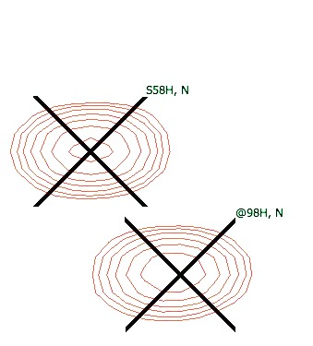
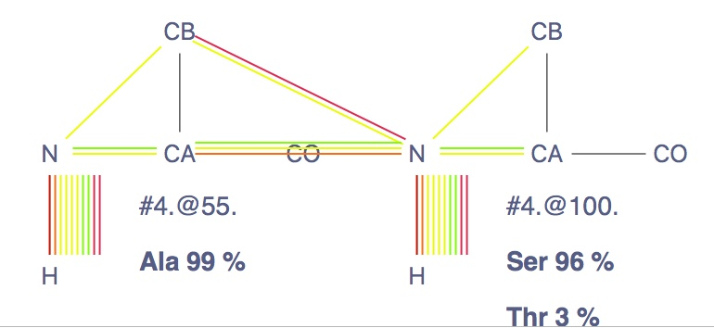
CcpNmr Analysis Version 3
Backbone Assignment Tutorial

Slide 2

Introduction
These tutorials are designed to guide you through a sequential triple resonance backbone assignment using Ccpnmr AnalysisAssign Version 3.0, they are not intended to teach any theoretical aspects of NMR. For a practical guide, please visit http://www.protein-nmr.org.uk.
In these tutorials you will use spectra recorded on Sec5, in particular hsqc, cbcaconh, hncacb, hncoca.
You will need four projects which are located in the directory: AnalysisV3/data/CcpnSec5BBTutorial.
The first two projects, Sec5Part1 and Sec5Part2 are used for the actual sequential backbone assignment, the others are examples of How-To do common assignment operations using different AnalysisAssign tools.
Start CcpNmr Analysis V3
Apple users by double clicking the icon CcpNmrAnalysis
Linux users by using the terminal command: bin/assign

Slide 3
1
Getting started, basic operations
Sidebar
All data contained in a project, such as spectra and peak lists are located in sidebar. Double click on an item will open the properties popup.
Display
A display can contain multiple overlaid spectra. To show/hide a single spectrum, click on its toolbar button. If you close a display, you can open a spectrum by Drag and drop into the drop area from sidebar or right click on sidebar item and select “open as module”
Mouse
Pan -> Left Click and drag in display
Zoom in/out -> Scroll wheel in display
Context menu -> Right click
Select a peak -> Left click on a peak symbol “X”
Move a peak -> select first then hold Middle and drag
Shortcuts
The program uses several shortcuts, example “CL” for copying a peak list. You will need to press the first letter on your keyboard e.g. “C”, followed by the second letter, e.g. “L” (case insensitive).
Fore more commands and operations: main menu -> help -> Tutorial (Beginners) or Show Shortcuts

Slide 4
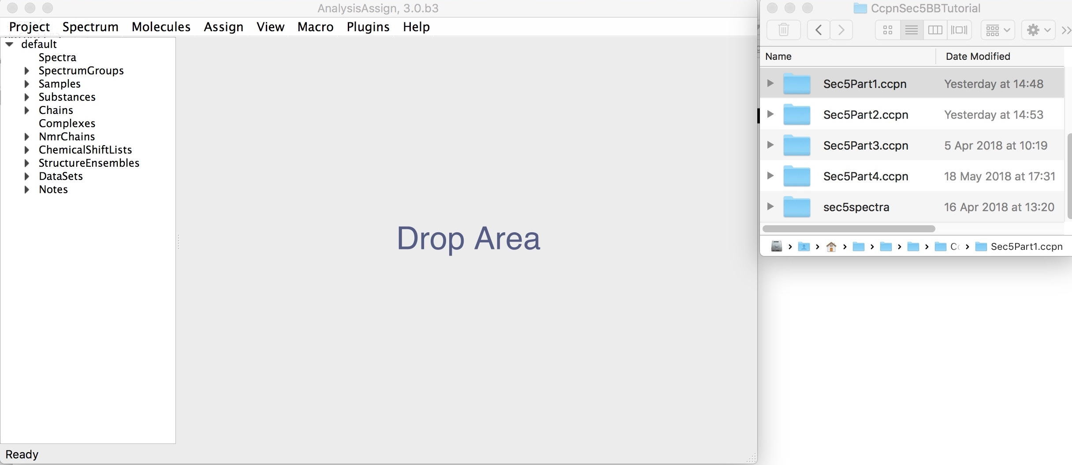
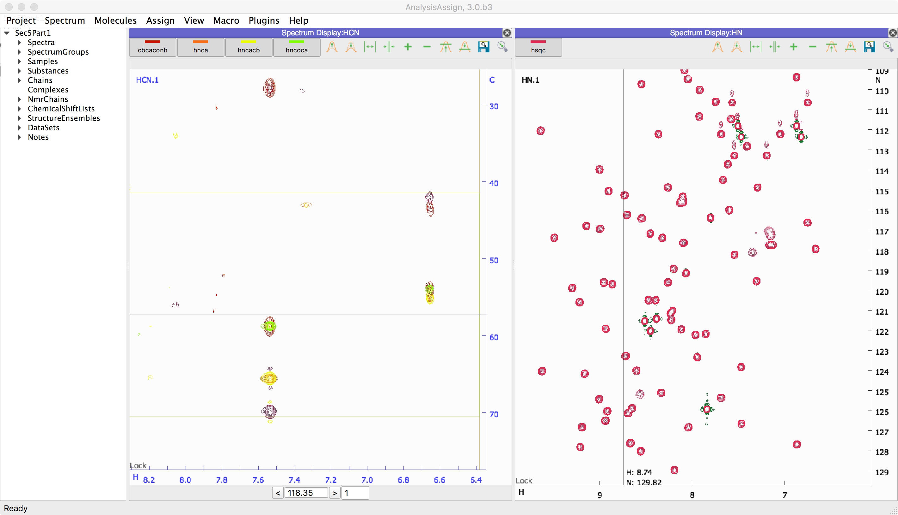
1
Setting up Project
Sec5Part1
Open project AnalysisV3/data/CcpnSec5BBTutorial/Sec5Part1.ccpn
1A
Drag & drop “Sec5Part1.ccpn” into the sidebar or drop area. CcpNmr projects have an extension of type “filename.ccpn”. Find the project file Sec5Part1.ccpn in the directory AnalysisV3/data/CcpnSec5BBTutorial.
Select the file “Sec5Part1.ccpn”, drag and drop into the program. The Sec5Part1 project will be loaded in a new window.
You will see five spectra, displayed in two Spectrum Displays as:
hsqc (red, HN)
cbcaconh (red, HCN)
hnca (orange, HCN)
hncacb (yellow, HCN)
hncoca (green, HCN)

Slide 5
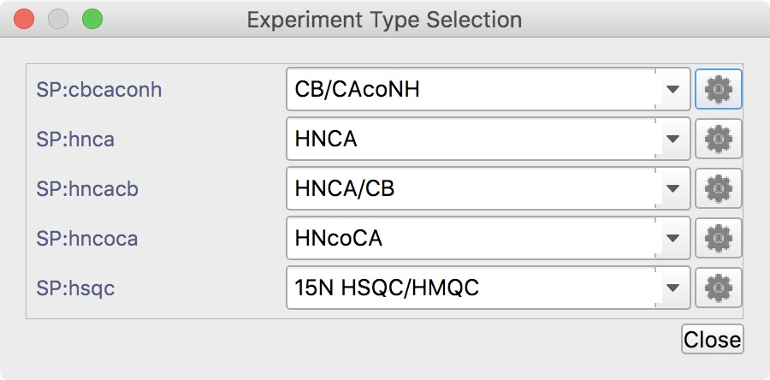
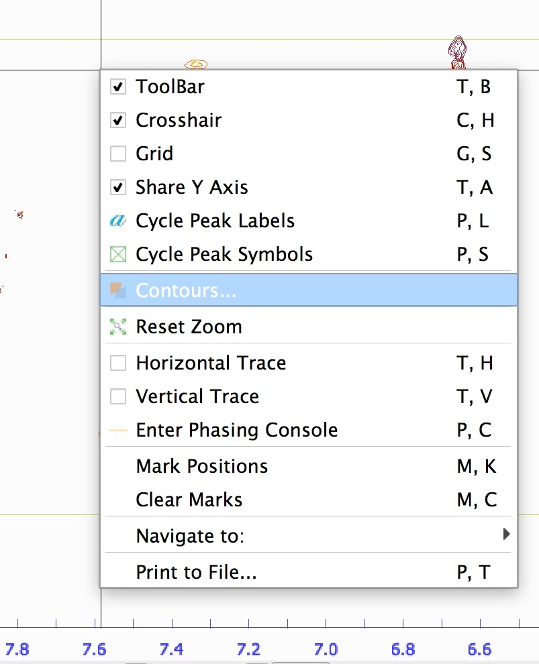
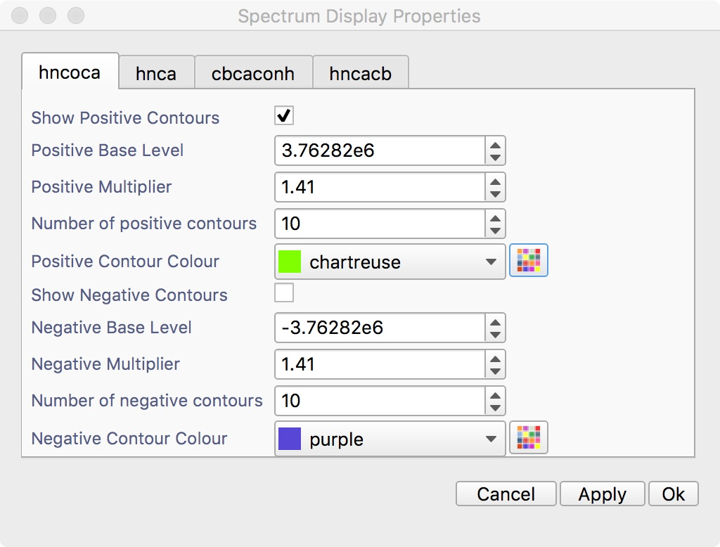
1
Setting up Project
Sec5Part1
Set experiment types
Set contours
Right click on Spectrum Displays HN and HCN
If the contours are not displayed correctly, verify the path is set correctly on the Spectrum properties popup under the General tab options; open it from the sidebar items. Spectra are located inside the directory: AnalysisV3/data/CcpnSec5BBTutorial/sec5spectra.
1B
Set Spectrum Properties: Experiment types and contours.
Set experiment types: Main Menu ⟶ Spectrum⟶ Set Experiment Types, shortcut ‘ET’. You might copy and paste the following:
CB/CAcoNH
﻿HNCA
﻿HNCA/CB
﻿HNcoCA
15N HSQC/HMQC
Contours:
right click on each spectrum display, click Contours…
uncheck “Show Negative Contours” except for the hncacb
You can also perform these actions for each individual spectra on the Spectrum properties popup; open it from their sidebar items.

Slide 6
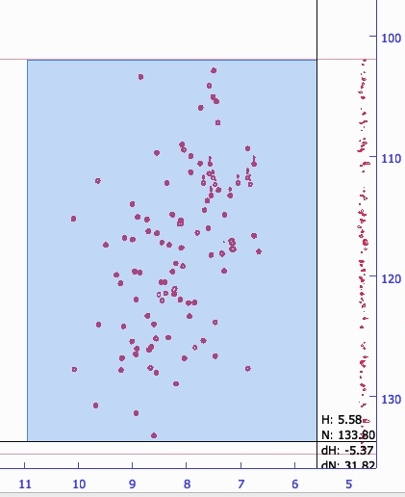
2
Picking Peaks
Sec5Part1
Mac:
Linux: ctrl
The “Peak Picking Drop” parameter in the “Preferences” popup (Menu: Project⟶Preferences, tab Spectrum) affects peak picking. This parameter defines the percentage the intensity must drop from a local maximum (for positive peaks) in each dimension in each direction, in order for the position of the local maximum to be considered to be a peak. If this percentage is too high then some actual peaks might be missed, and if it is too low then too many peaks might be picked.
2A
Picking peaks on the SP:hsqc
You can pick peaks either manually or automatically.
Manual Picking: CTRL or CMD (for Mac) + SHIFT + Left drag
Click on the spectrum display, hold down CTRL or CMD (for Mac) plus SHIFT and Left drag the mouse to create a blue picking box in the regions:
H → 11-6
N → 102-134.50
then release the button and keys

Slide 7
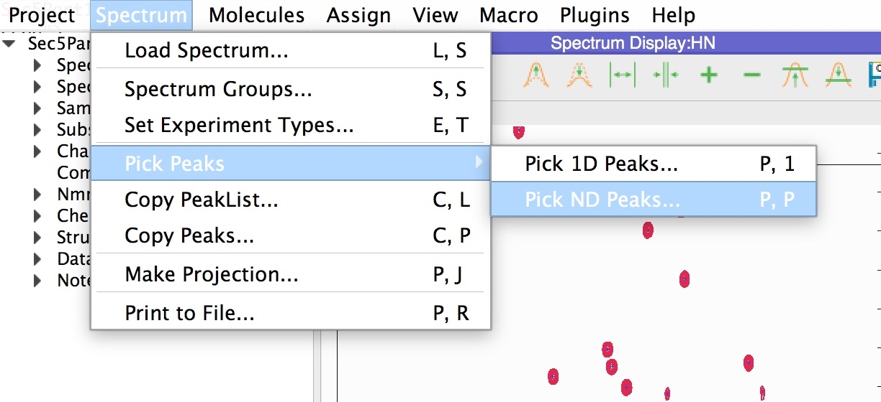
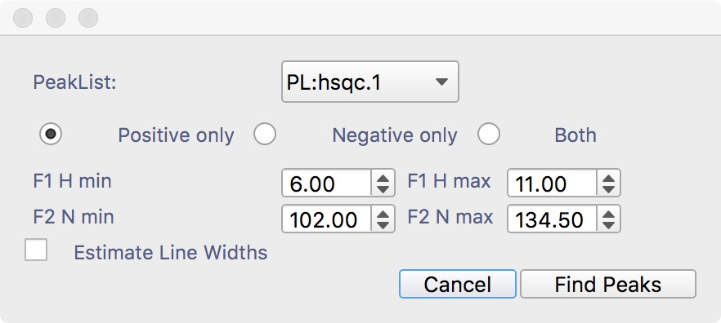
2
Picking Peaks
Sec5Part1
or Shortcut ‘ PP ’
2A
Automatic Picking (if you haven’t picked previously) :
Main Menu ⟶ Spectrum⟶ Pick Peaks ⟶ Pick ND Peaks… , shortcut ‘PP’
Select Positive only
Set F1: 6-11
set F2 102-134.5
Click Find Peaks
Result:
The crosses in the spectrum mark the peak positions picked. The hyphens separated by a comma indicate that the dimensions of these peaks are unassigned
-,-

Slide 8
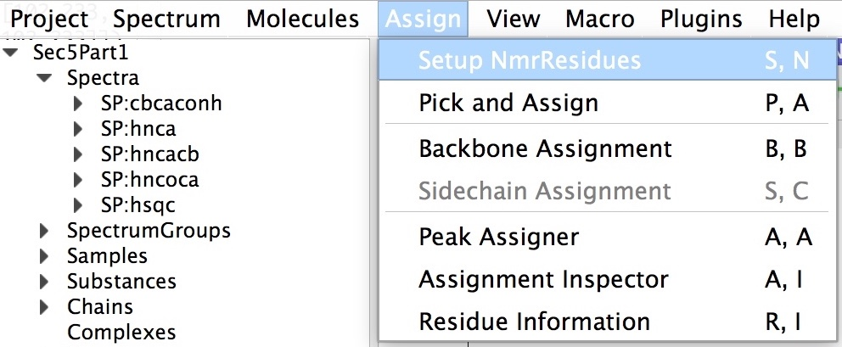
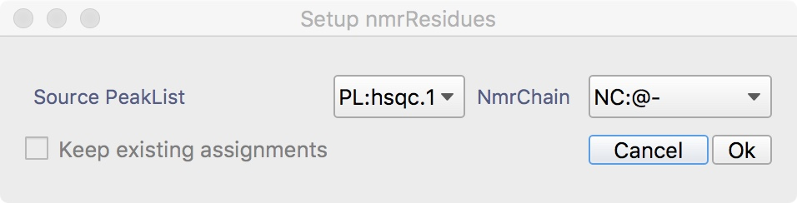
3
Setting up Assignment
Sec5Part1
or Shortcut ‘ SN ’
To start the backbone assignment process, we need to define ‘anonymous’ NmrAtoms, i.e. effectively labels, for the two dimensions of the 15N-HSQC peaks, which can subsequently be linked to the 3D spectra and used as placeholders until the actual assignments are obtained. See at the end of Point 3 for a full explanation of the AnalysisAssign nomenclature.
3A
Setup NmrResidues
Main Menu ⟶ Assign⟶ Setup NmrResidues, shortcut ‘SN’
Source PeakList: PL:hsqc.1
NmrChain: NC:@-
Click Ok
Each peak will have now a label like @1Hn,Nh. Use the shortcut ’PL’ to switch how to display the peak labels.

Slide 9
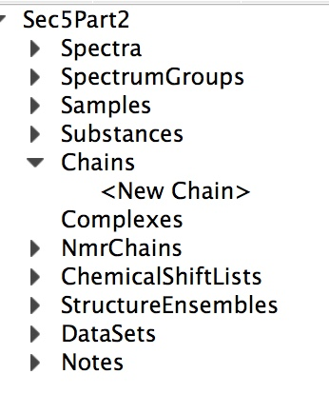
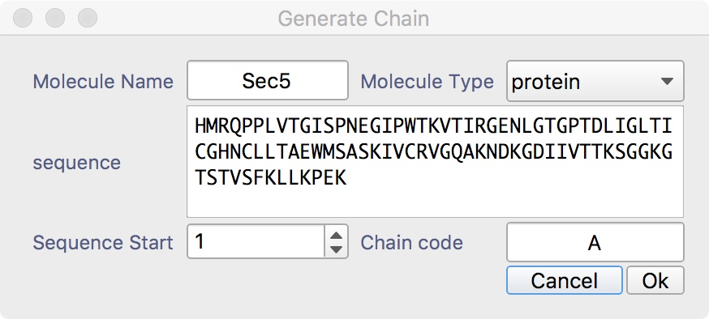
3
Setting up Assignment
Sec5Part1
Double click
3B
Create Chain
Sidebar ⟶ Chains ⟶ <NewChain>
﻿Molecule Name: Sec5
ChainCode: A
Sequence: (copy and paste) HMRQPPLVTGISPNEGIPWTKVTIRGENLGTGPTDLIGLTICGHNCLLTAEWMSASKIVCRVGQAKNDKGDIIVTTKSGGKGTSTVSFKLLKPEK
press Ok
You can also use Main Menu: Molecule->Generate Chain or drop a Fasta formatted file onto the Sidebar

Slide 10
3
Setting up Assignment
Assignment nomenclatures (Explanation only)
Assignment in AnalysisAssign is simply a matter of setting strings that define the NmrAtoms.
We call this the ‘id’ (id: identifier) of the NmrAtom. If an id matches the strings defining a molecular Atom¹,this effectively constitutes an assignment to the Atom.
If not, the NmrAtom id is a placeholder, reflecting its progress towards assignment².
At this point, it is appropriate to also consider the relationships between Peak, ChemicalShift and NmrAtom. Each dimension of a Peak is assigned to one or more NmrAtom. The ChemicalShift (which resides in a ChemicalShiftList) of an NmrAtom, is defined by all the peaks that have assigned to this NmrAtom assignment. Hence, changing an assignment for a Peak (e.g. reassigning a peak from “nmratom_1“ to another “nmratom_2”) has an effect on the ChemicalShift of “nmratom_1”, as it is now no longer defined the Peak. Likewise, it also affects the ChemicalShift of the “nmratom_2”, as it is now becomes to be (also) defined by the Peak. We will see in next sections how to inspect and change the assignment(s) of a Peak.
If you change the id of an NmrAtom (or its parent NmrResidue or NmrChain), the assignment of all ChemicalShifts and Peaks are updated.
We use NmrChains and NmrResidues to keep track of the NmrAtoms during the assignment process. By default, new NmrResidues are put in NmrChain '@-', and new, temporary NmrChains are given names like '@2'. Initially, NmrChains contain no information about the sequential connections of the NmrResidues, i.e. their ordering. In this case, the NmrChain functions like a simple list with all its NmrResidues.
To store sequential stretches, i.e. lists in which the NmrResidues are ordered, the program uses 'connected' NmrChains, whose names start with '#' instead of '@'. Consequently, names with '@' (and NmrChain names starting with '#') are reserved.
NmrResidues are created with names like '@173' and with no residueType. When you want to create the previous, 'i-1' residue to a given residue (for backbone assignment) you give it a '-1' suffix, in this case '@173-1'. When you assign the NmrResidue to a real residue, renaming it e,g, 'A.45.GLY', the i-1 residue name updates to 'A.45-1. .
NmrAtom names always start with the nucleus, and default names would be e.g. 'H@31' or 'C@88'. Some names have a special meaning:
'%' means 'any number', so 'HB%' would be a beta methylene or methyl group. 'H%' would be the backbone NH3 group.
'*' means 'any string', so 'H*' would be 'any proton in the residue'
Names starting with 'M' and 'Q' are (proton) pseudoatom names
Number suffixes follow NEF (IUPAC) convention, so serine HB2 or HB3 denote stereospecific assignments.
Suffixes 'x' and 'y' are used for non-stereospecific pairs - the normal assignment to serine beta would use HBx and HBy. For e.g. isopropyl groups the x and y assignments match up between ¹H and ¹³C so that Leu HDx% are the methyl protons bound to Leu CDx (NEF convention).
¹ Atoms reside in Residues, which reside in Chains; multiple chains can form a Complex.
² The id together with the type identifier forms the so-called pid, the project-identifier. As an example for an un-assigned amide in the 123rd NmrResidue in the second NmrChain: NA:@2.@123..H. For an assigned NmrAtom, all the fields will have been filled, yielding something like NA:A.GLU.14.H.

Slide 11
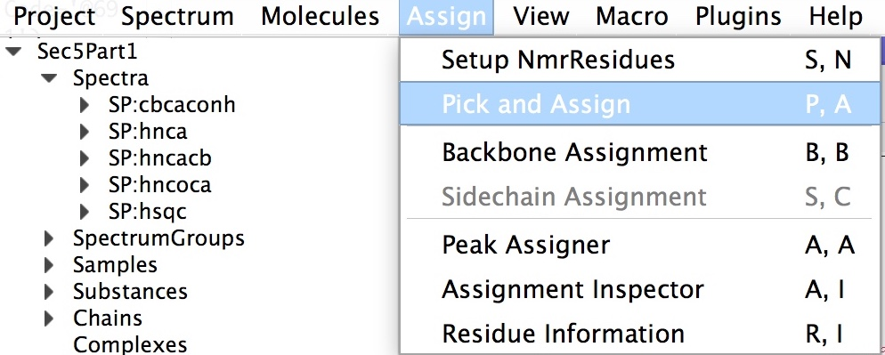
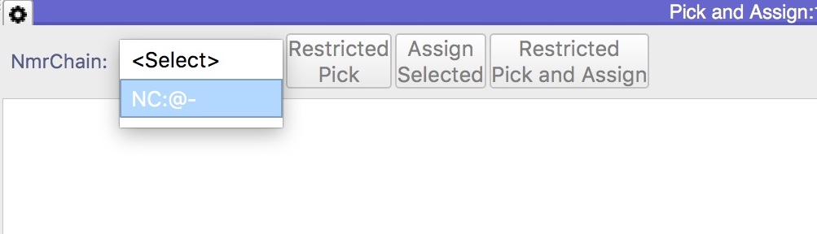
3
4
Assign 3D spectra
Sec5Part1
or Shortcut ‘ PA ’
The “Pick and Assign” module has a settings panel (click to toggle) that gives access to the parameters that determine in which spectra and with what tolerances the program tries to pick the peaks
4A
Pick and Assign Nd peaks
To link the 3D spectra to the HSQC spectrum we will use the “Pick and Assign” module.
Go to the main menu: Assign⟶Pick and Assign module or use the shortcut “PA”.
Select the NmrChain: NC:@-.
Double click on a row in the table, e.g. the row for @1.
This will cause the spectrum display with the HSQC spectrum to focus on the position of the peak labelled @-.@1..H, N and to mark this position with two labelled rulers corresponding to each dimension. Likewise, in the 3D module navigates to the corresponding z (i.e. N) position and marks the appropriate frequency along the proton axis with a labelled ruler.
Click the “Restricted Pick” button.
This will pick all the peaks along a narrow region in the 3D window and these peaks will be selected.
Inspect the 3D peaks and delete any noisy ones.
Select the peaks to assign and Click the “Assign Selected ” button.

Slide 12
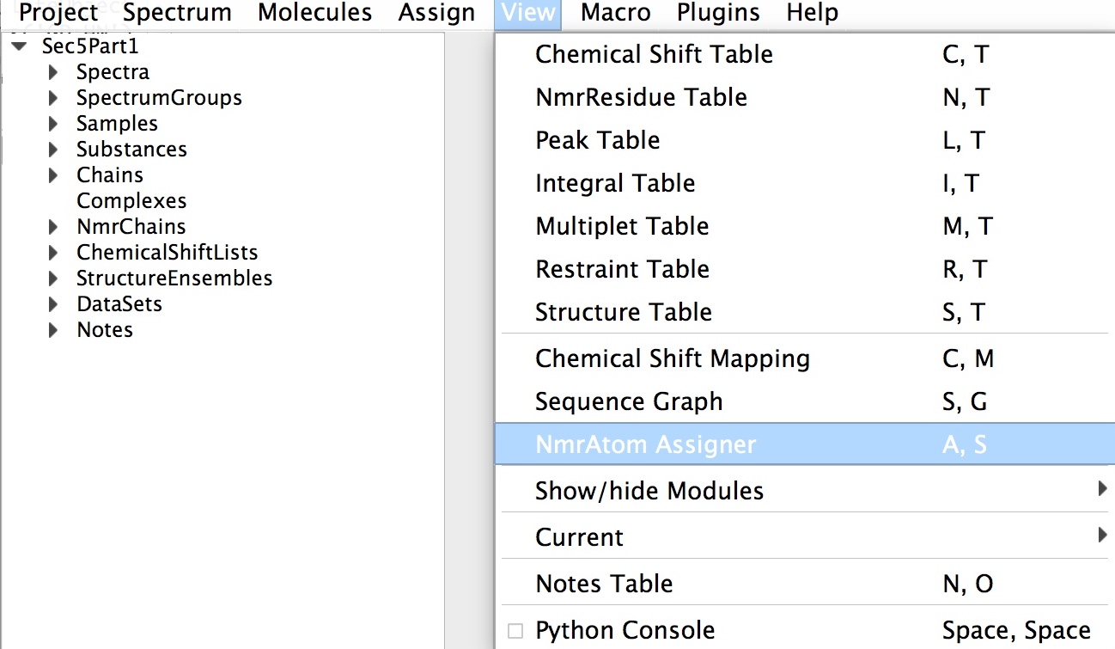
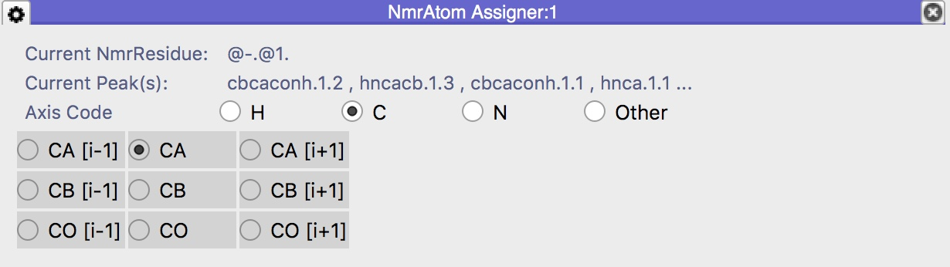
3
4
Picking 3D spectra
Sec5Part1
or Shortcut ‘ AS ’
4B
Complete assignment for the carbon dimension
Go to the main menu: View ⟶ NmrAtom Assigner module or use the shortcut “AS”.
Toggle any nmrAtom button to assign it to the selected peak(s).
Select a single peak in the 3D window to predict the assignment for the carbon dimension. The program uses green for likely and orange for less likely assignments.
In the event you assign the wrong nmrAtom, you can simply toggle another nmrAtom or deselect it to de-assign the peak.
Repeating this procedure for the other groups of peaks along this line will also yield the CBi-1 and CBi assignments for this NmrResidue.

Slide 13
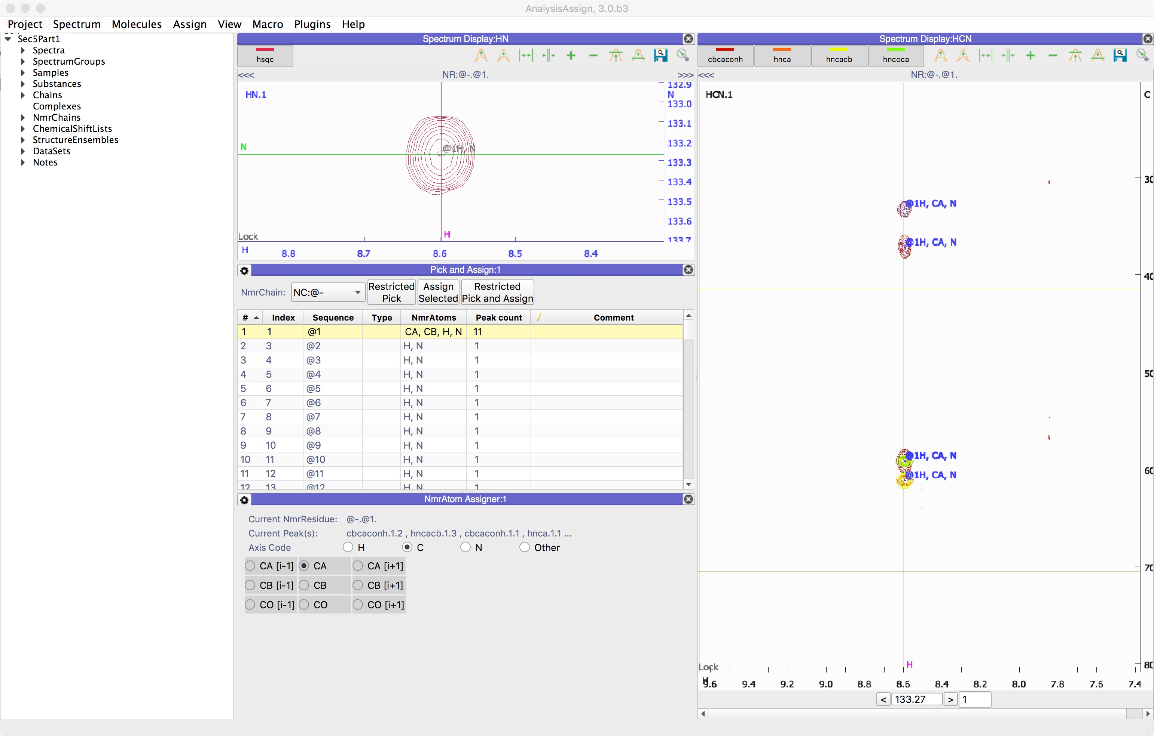
4
Assign 3D spectra
Sec5Part1
4C
Continue the CBi-1 and CBi assignments (Optional)
To use the sequential Backbone Assignment tools in AnalysisAssign, the i and i-1 assignments for all NmrResidues needs to be provided, so the earlier described procedure should be carried out for all NmrResidues listed in the Pick and Assign table, where possible.
If you move on to assign NmrResidue @2, after double-clicking you will see no peaks in the “HCN” spectral display; this NmrResidue originates from a Tryptophan side chain NH and hence does not display the triple-resonance peaks. Move on to NmrResidue @3 to continue, and so on for a few more residue to get the hang of it.
You might re-arrange the modules to better suit your work-flow.
We suggest an arrangement as shown in figure the above.
Once all the 3D peak dimensions have been assigned to the appropriate NmrAtoms, the backbone assignment can be carried out, but obviously for this tutorial we provide you with a CcpNmr project in which this was already completed.

Slide 14
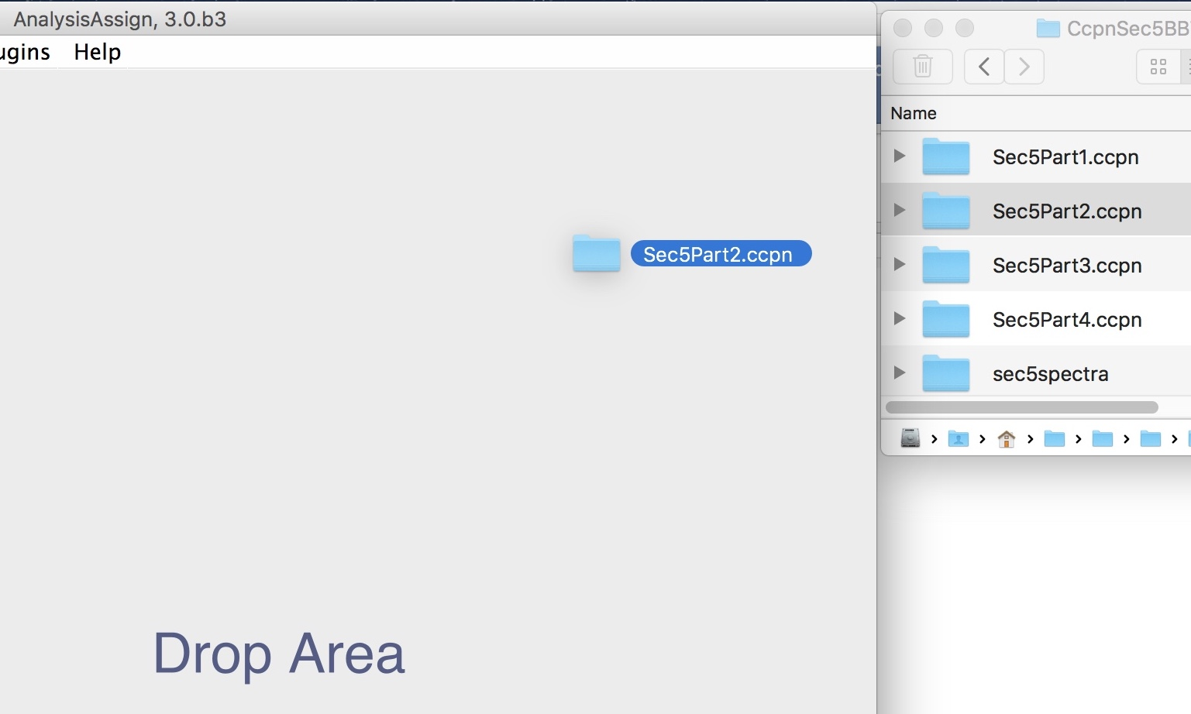
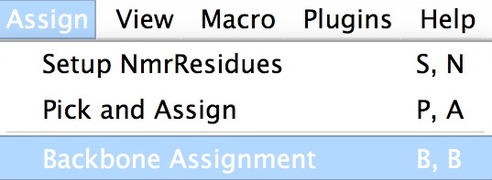
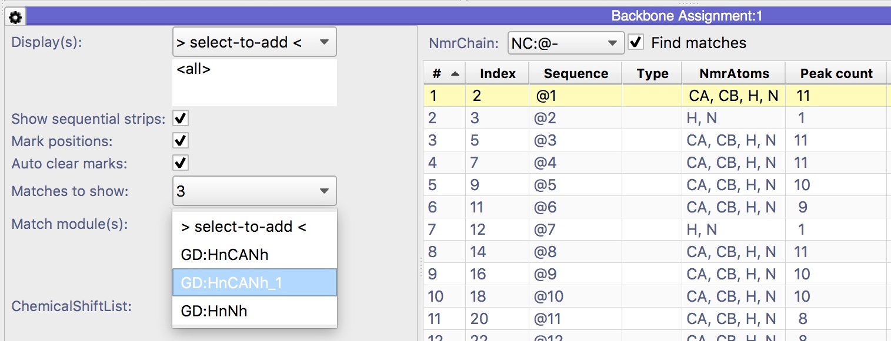
3
Sequential backbone assignment
5
Sec5Part2
Sec5Part2.ccpn is a project wherein all the carbon atom type assignments for the NmrResidues have been completed and thus can be used directly for the sequential backbone assignment. The project can be found in: AnalysisV3/data/testProjects/CcpnSec5BBTutorial
5A
Open Sec5Part2.ccpn
Open the project Sec5Part2.ccpn, drag and drop on the drop area or sidebar. Quit with or without saving the current Sec5Part1.
or Shortcut ‘ BB ’
5B
Open and set the backbone assignment module
Main Menu ⟶ Assign⟶ Backbone Assignment or shortcut ‘BB’
Select the NmrChain: NC:@-.
Open the settings (gear icon) and select:
Display: HnCANh_1
Leave the rest as default and close the settings

Slide 15
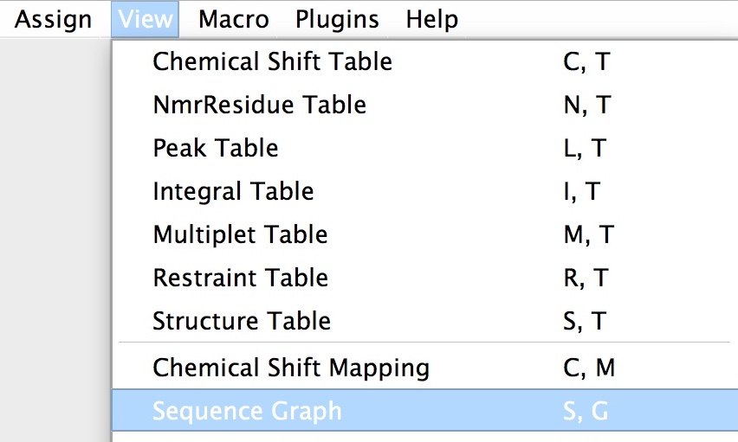
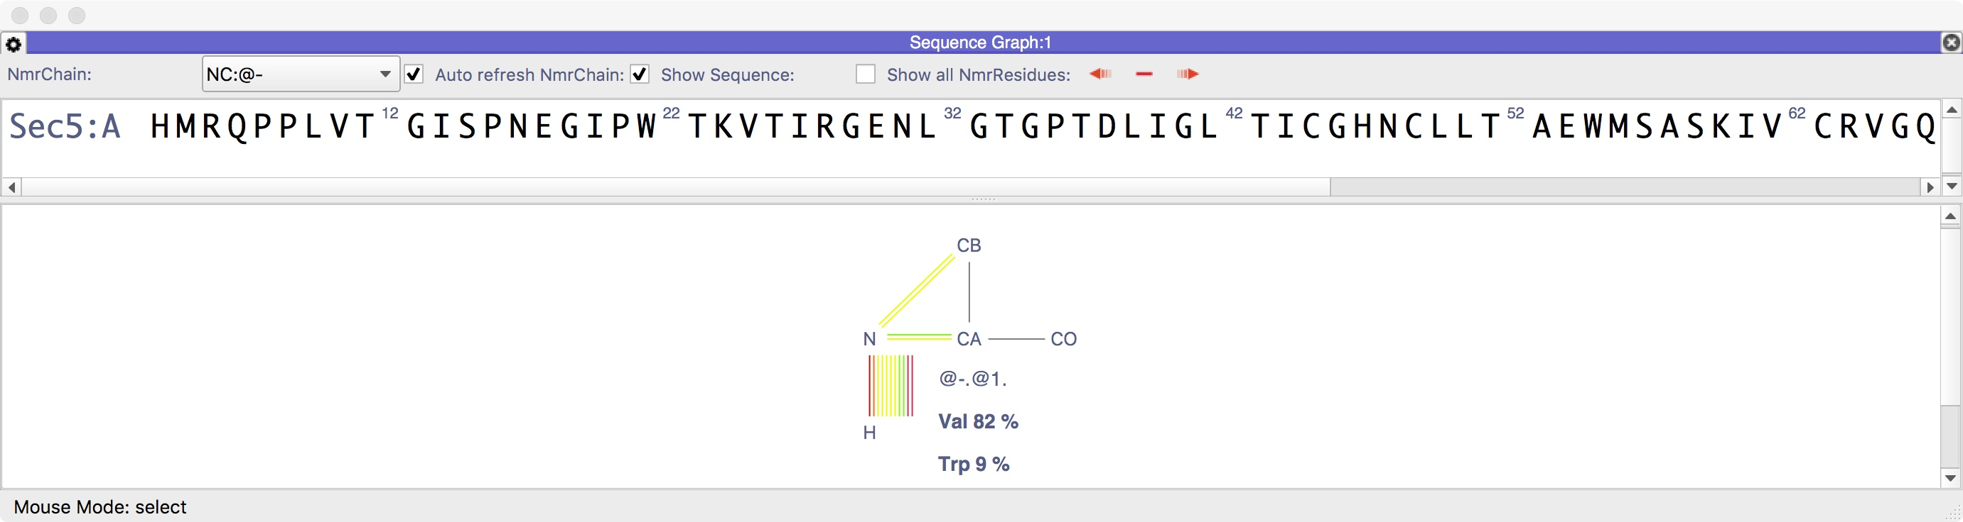
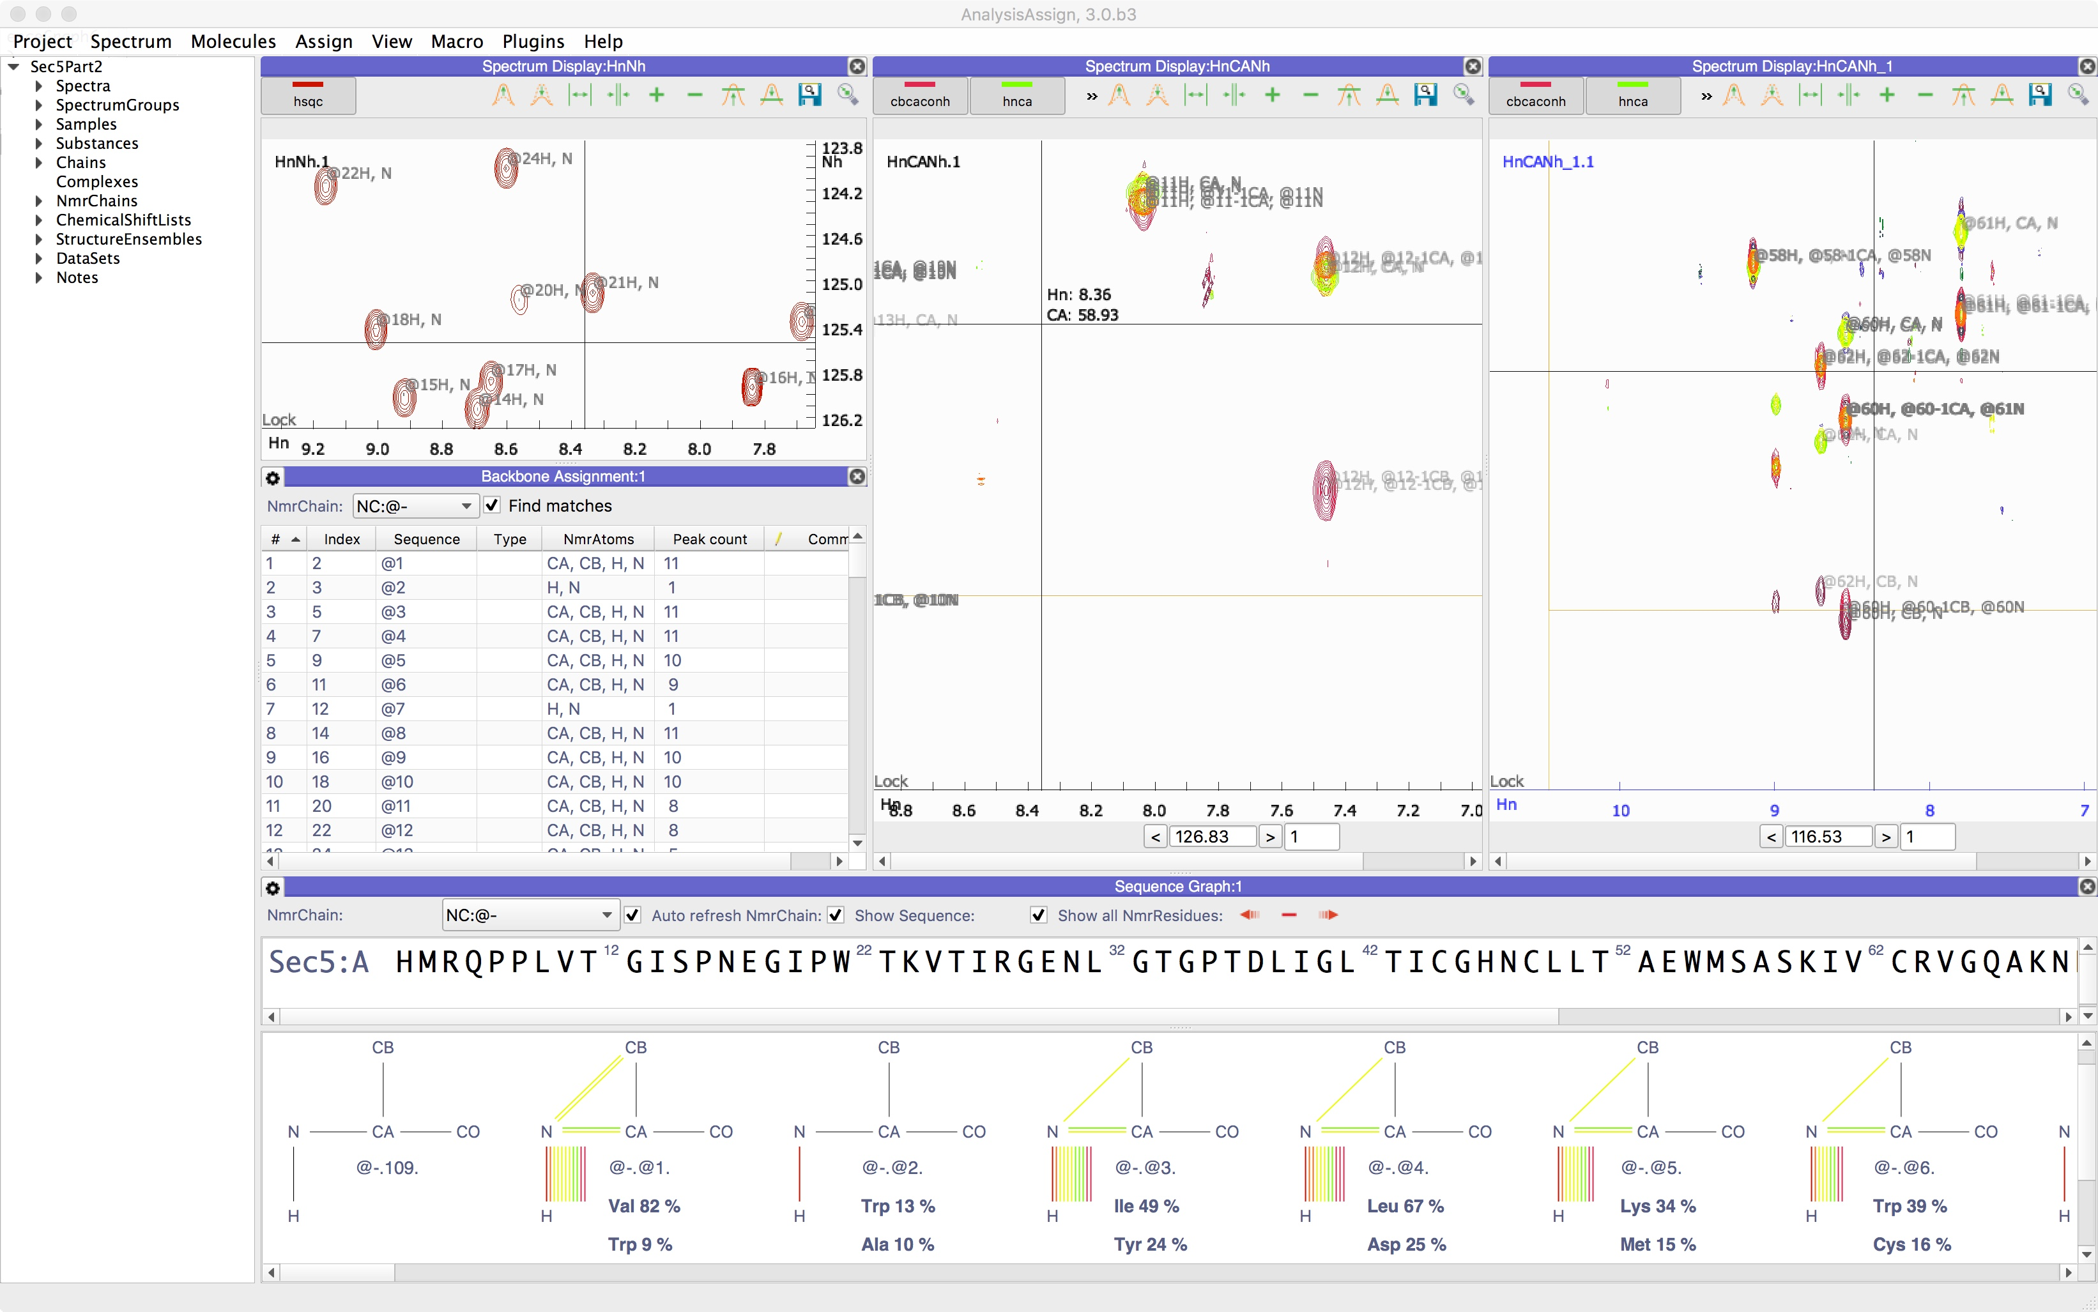
3
Sequential backbone assignment
5
Sec5Part2
or Shortcut ‘ SG ’
5C
Open and set the Sequence Graph module
Main Menu ⟶ View ⟶ Sequence Graph or shortcut ‘SG’
Select the NmrChain: NC:@-
uncheck: Show all NmrResidues
Rearrange the modules to a layout like the Figure below.

Slide 16
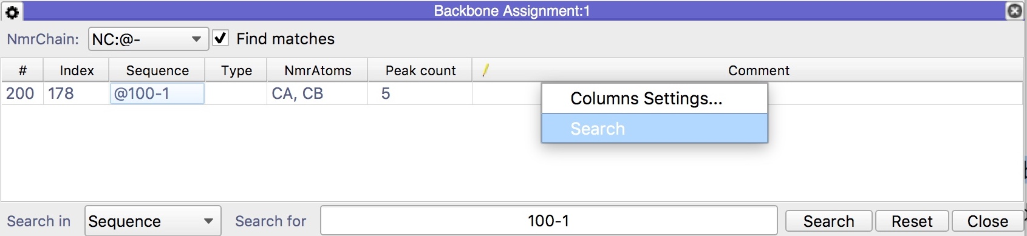
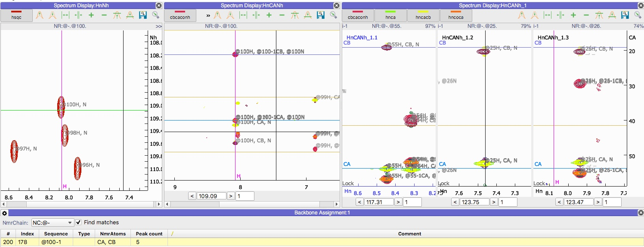
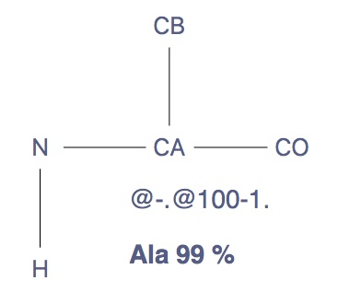
3
Sequential backbone assignment
5
Sec5Part2
Right click on header
Double click @100-1
5D
Assign in the i-1 direction
Right click on the Backbone Assignment module table header and click on search
search for the @100-1
Double click the row. You will see a series of changes in the GUI. The HnCANh module will navigate to the appropriate plane containing the assignment for the NmrResidue @100; the relevant frequencies of @100 are marked in the spectra.
The Sequence Graph will have a schematic residue drawn, labelled with the NmrResidue name (@100) and predictions of the possible residue type(s) below it. The match module (HnCANh_1) will display three strips in order (left to right) that the AnalysisAssign algorithm thinks best match the i-1 chemical shifts of @100. (C-terminal of the residue @100)

Slide 17
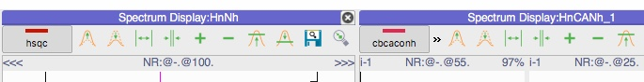
3
Sequential backbone assignment
5
Sec5Part2
Select and drag @55
Drop on <<<
5E
Connecting nmrResidues
Upon examination, the first strip in module HnCANh_1 shows nmrResidue @55; the H, CA and CB marks align with the peaks of this residue, we can therefore see that is the best match for @100-1.
Select the strip label NR:@-55 on the spectrum display HnCANh_1
Drag and drop the label to the <<< icon on the Spectrum display HnCANh
Check Show all NmrResidues on the Sequence Graph module to see the new connection
At this point @100 an @55 have been put into a so-called connected stretch (cf. section 3) and they are in a new nmrChain called #4, which means that their names have changed to #4.@100. and #4.@55. The nmrChain pulldown in the module is automatically set to #4.
When strips are dragged and dropped through this procedure, AnalysisAssign will subsequently look for i-1 matches for @55. The algorithm thinks that @72 is a good match for @55-1 and on inspection it is a match, so selecting and dragging @72 onto the <<< of HnCANh will carry the assignment on.

Slide 18
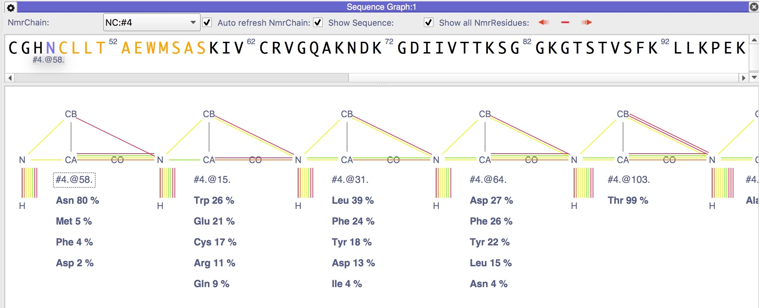
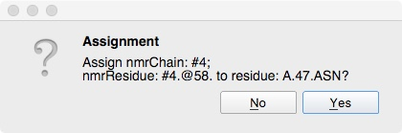
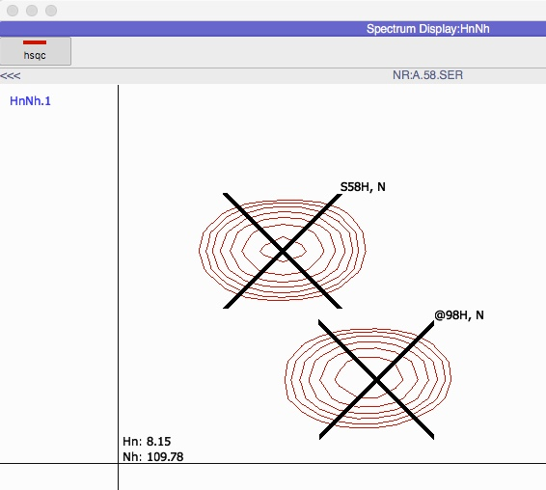
3
Sequential backbone assignment
5
Sec5Part2
Drop on N
5F
Link NmrChain to Chain
If you continue assigning in the i-1 direction, you should end up with a stretch consisting of:
@58 @15 @31 @64 @103 @25 @23 @6 @19 @72 @55 @100
and NCLLTAEWMSAS highlighted in the sequence.
Select the label #4.@58 from the Sequence Graph and drop it to the left foremost residue in the highlighted sequence above it
Click Yes in the confirmation popup
You may notice a new NmrChain “A” has been automatically created and is linked to the chain “A” for the above nmrResidues-Residues.
Now the relevant hsqc peaks for the selected stretch are fully assigned. You can inspect this on the hsqc spectrum display.

Slide 19
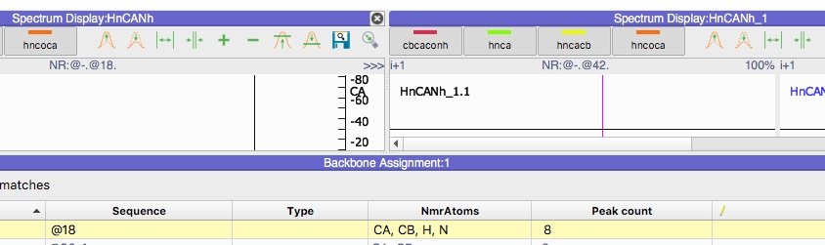
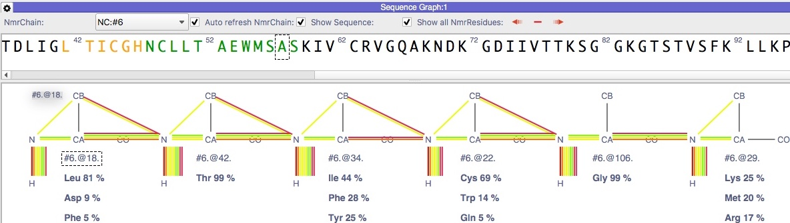
3
Sequential backbone assignment
5
Sec5Part2
Drop on
>>>
5G
Assign in the i+1 direction
The Sequential backbone assignment in the i+1 direction is fully analogous to the ‘i-1’ direction except you will need to drop the strip label on the >>> icon.
Go to the Backbone Assignment module table
Select chain @- (to display all nmrResidues again)
Double click on @18
Go to the Spectrum Display:HnCaNh_1
Select the best match @42, drag and drop it onto the HnCaNh >>> icon
Continue in this direction to have a stretch consisting of: @18 @42 @34 @22 @106 @29
Select the @18 from the Sequence Graph, drag and drop onto the “L” of stretch LTICGH in the sequence above it
Click Yes in the confirmation popup
This completes the steps required for a Sequential Backbone Assignment. The following parts of this tutorial are How To’s and cover the usage of other Backbone Assignment tools, in particular how to inspect the assignment and edit it.

Slide 20
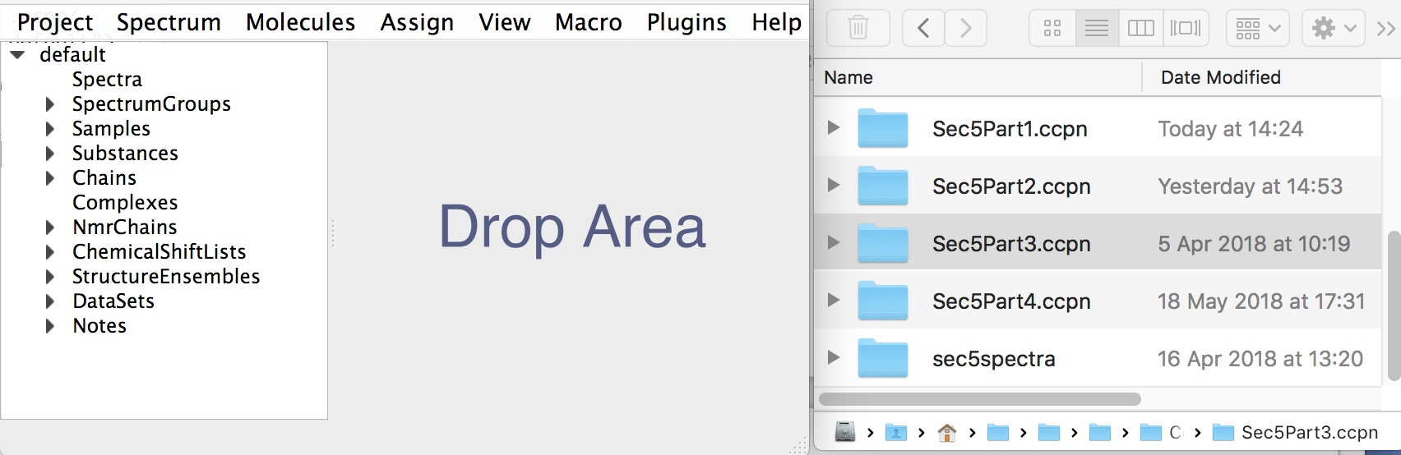
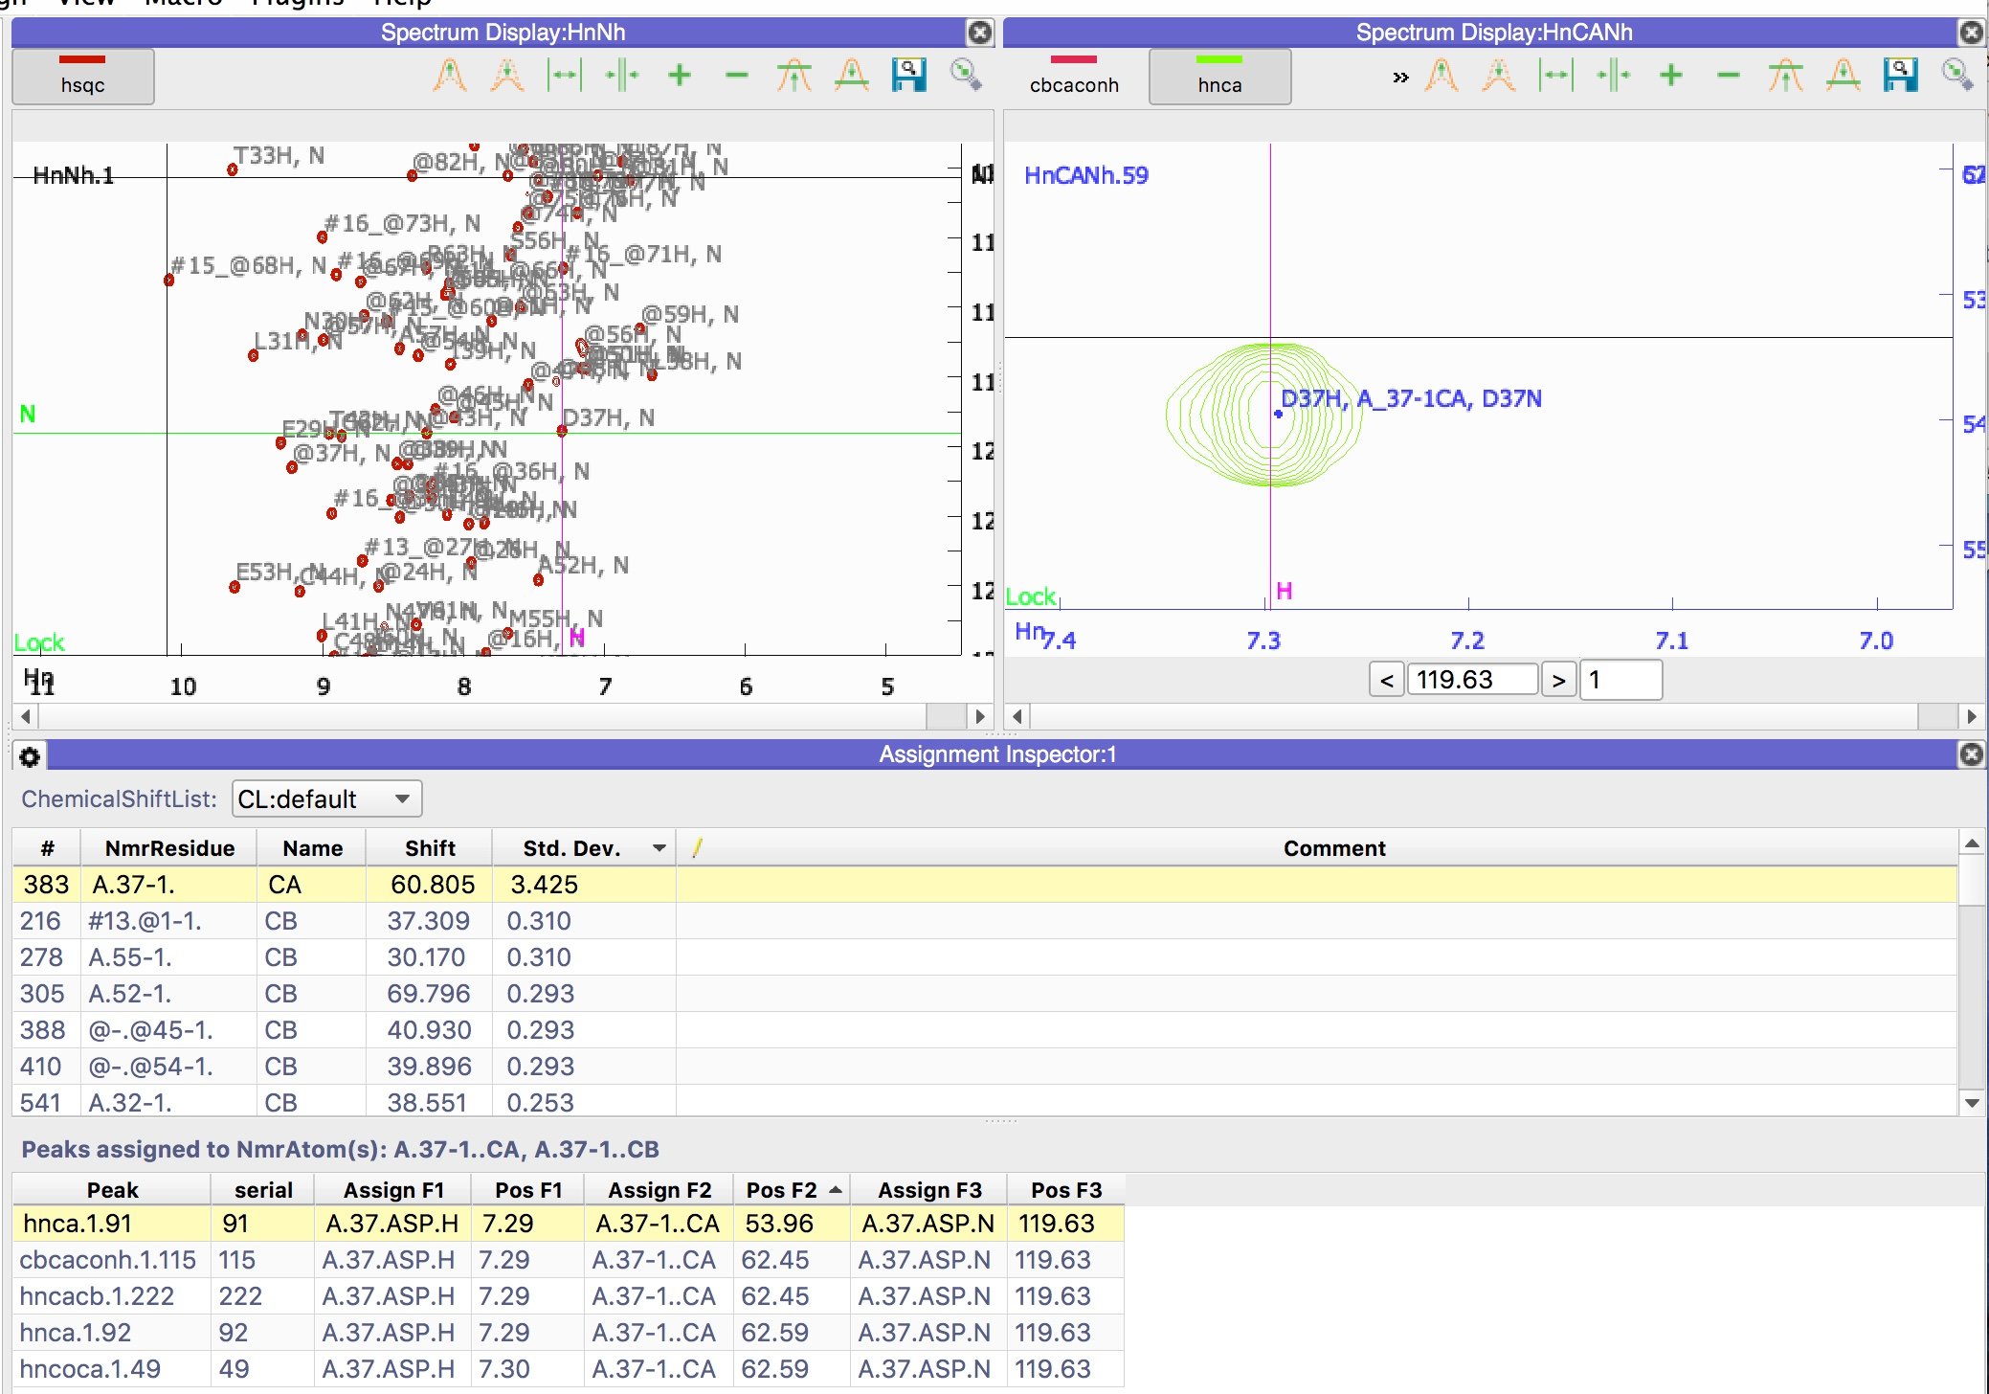
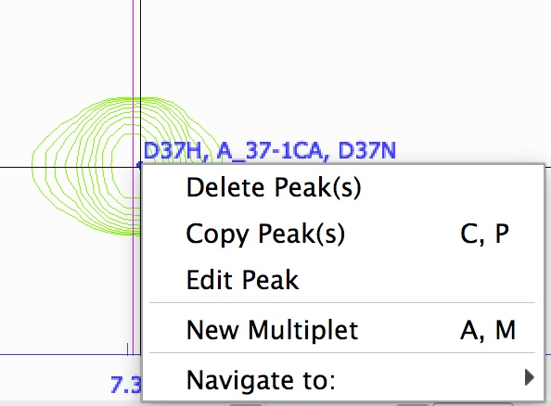
How To
1
Inspect Assignment
Sec5Part3
Open Sec5Part3
Open Assignment Inspector ‘ AI ’
Sort ⬇
Single click
Sort ⬆
Double click
Sec5Part3.ccpn is a project that contains a rather obvious assignment error; the NmrResidue 37-1 has a very high standard deviation (as calculated from all peaks) . We will to correct this mistake using Assignment Inspector and Peak Assigner modules.
1A
Correcting assignment mistakes
Open the project Sec5Part3
Open the Assignment Inspector module: Main Menu: Assign ⟶ Assignment Inspector or shortcut ‘AI’
select chemicalShiftList: CL:default
sort high-low the top table by Std. Dev
select nmrResidue 37-1; the peak table below will populate
sort the peak table by Pos F2
double click on peak hnca.1.91
zoom in to the peak on the hnca spectrum display
right click on the peak, select edit Peak; the Peak Assigner module will appear

Slide 21
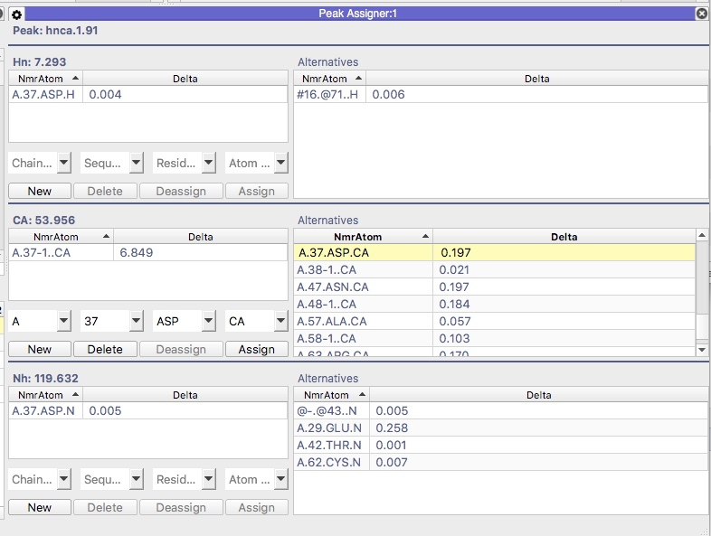
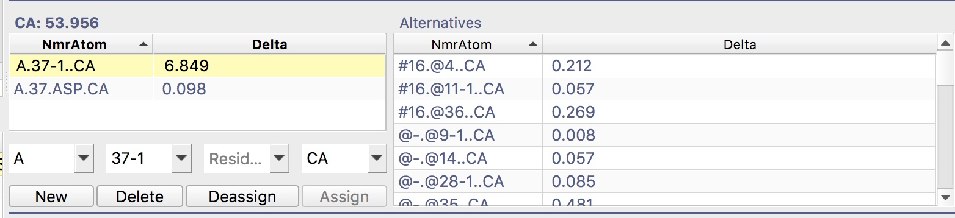
How To
1
Inspect Assignment
Sec5Part3
Double click
to assign
Double click
to de-assign
The Peak Assigner is very versatile and it has a number of options to guide its behaviour. Use the gear box to show/hide these. Crucial parameters are the assignment tolerances along each dimension for the different spectra. These are set to (sensible) default values but can also be modified by using the “dimensions” panel of the spectral properties popups of the respective spectra. You can also open the module from the main menu → Assign → Peak Assigner (shortcut “AA”)
1B
Edit Assignment
Double click on A.37.ASP.CA on right table located in the middle panel; this will assign the atom to the selected peak
Double click on A.37-1.CA on left table; this will delete the atom from the selected peak and the project

Slide 22
How To
1
Inspect Assignment
Sec5Part4
Open Sec5Part4
Right click H
Sec5Part4.ccpn is a project that contains a assignment error; To identify assignment errors you can use the sequence graph. In this project, scrolling through the sequence graph of nmrChain A, you will notice multiple lines connecting the N atom of A.21.TRP to atoms much further down the sequence; in fact they go to the H of A.71.LYS and the CB of A.70.ASP. These are clearly mistakes in the assignment and should be corrected.
1C
Correcting assignment mistake
Open the project Sec5Part4
Open Sequence Graph with shortcut “SG”
Select NmrChain NC:A
Toggle settings, check Show Tree
Scroll to the right and search for A.21.TRP
Select the H, Right click on it
search and click all A.21.TRP peaks from the submenus so to remove the unwanted connections
The wrong connections have been removed, which means the peaks have been de-assign from that NmrAtom. You can further edit the NmrAtom using the other tools of Assign like the Peak Assigner module.

Slide 23
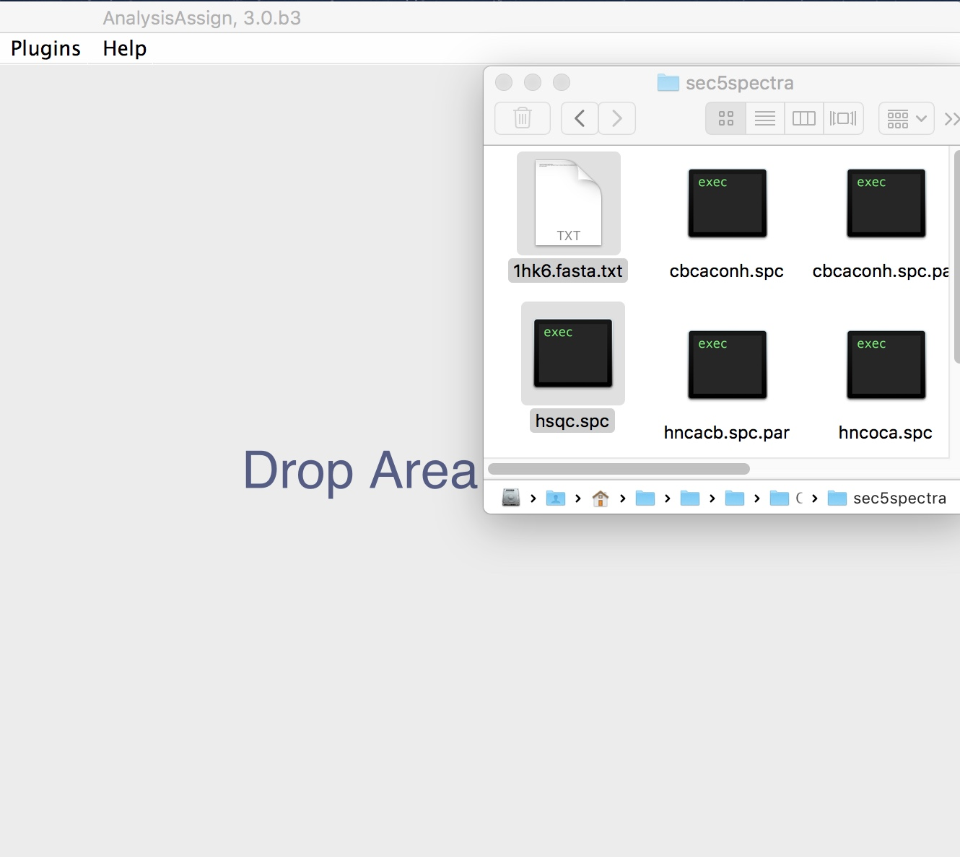
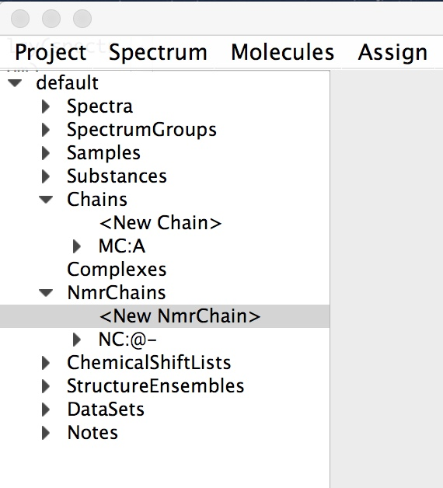
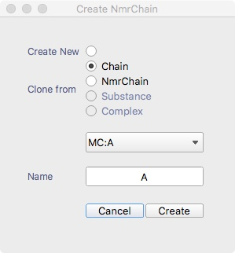
How To
2
Quick Assignment
Double click
Assuming you have pre-knowledge of a peak assignment, this HOW-TO will show how to assign residues and atoms to any dimensionality peaks in few simple steps.
2A
Create Chain and NmrChain
Open a new project
Drop the hsqc spectrum from the Sec5Spectra folder
Drop the Fasta file 1hk6.fasta.text
Double click on <New NmrChain>
Select Clone from: Chain
Select Chain A on the pulldown
Name: A
click Create
Open the hsqc from sidebar

Slide 24
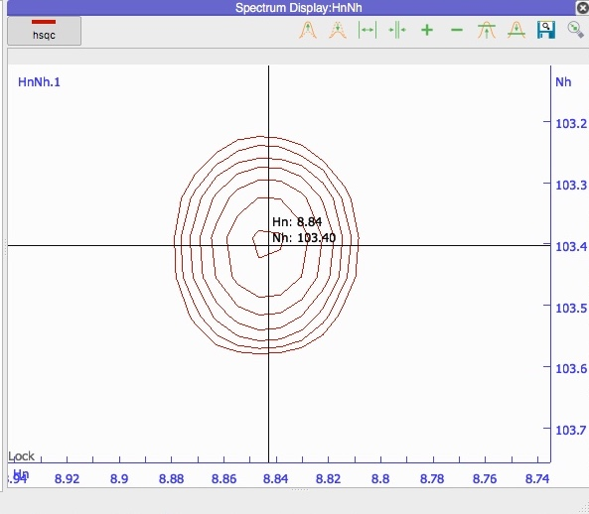
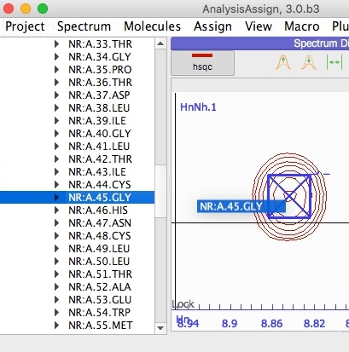
How To
2
Quick Assignment
Double click
2B
Drop the NmrResidue onto a selected peak
Zoom at positions: 8.84 – 103.40
Pick the peak with Ctrl (cmd) + shift (⬆︎) + right click
On sidebar expand the NmrChain A
Search nmrResidue 45
Drag and drop the item on the selected peak
The peak is now fully assigned for to the NmrAtoms H and N.

Slide 25
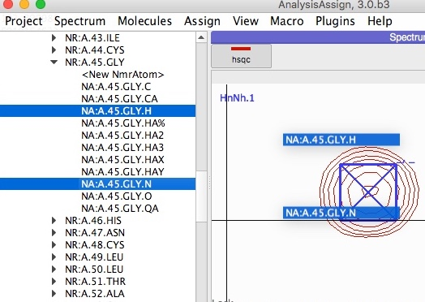
How To
2
Quick Assignment
You can assign any nmrAtoms to any dimensionality peaks if the NmrAtoms and spectrum axis Codes are matching (at least partially). E.g., you may assign 45.GLY.HA2 to any peaks of the HnNh spectrum but you cannot assign the Gly.O to any.
2C
Quick assignment edit
On sidebar expand the NmrChain A
Simulate a mistake by dropping a random nmrResidue on the selected peak
Expand nmrResidue 45
Drag and drop the nmrAtoms H and N on the selected peak. Multiple selection with cmd + right click.
The peak is now fully assigned to the new NmrAtoms.

Slide 26
CcpNmr Analysis Version 3
Contact Us
Website:
www.ccpn.ac.uk
Suggestions and comments:
ccpnmr3@google.com
Issues and bug report:
https://bitbucket.org/ccpnmr/issue-tracker/
Cite Us
Skinner, S. P. et al. CcpNmr AnalysisAssign: a flexible platform for integrated NMR analysis. J. Biomol. NMR 66, (2016)
Tutorial Version History:
beta1 (SS): First version beta2 (GWV): Minor changes
beta3 (LGM): Re-designed, re-written, added several steps

